Slide 1
Real Estate Investment Opportunities in 2025
Andrew Cheng
Paul Samaniego
Riya Gajjar
Madeline Cruz

Slide 2
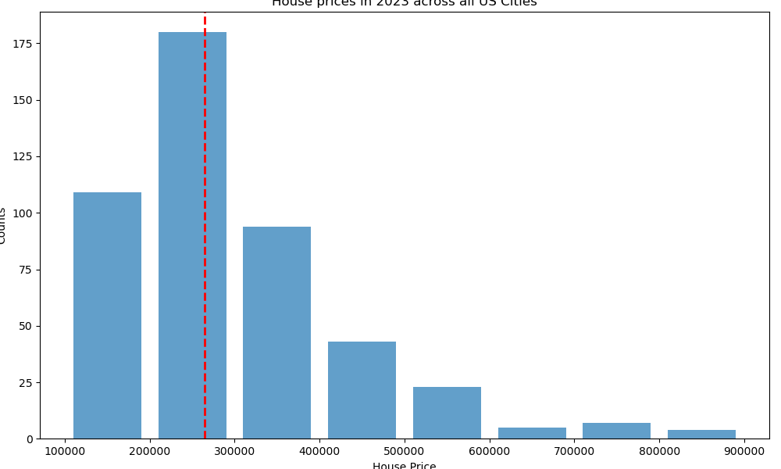
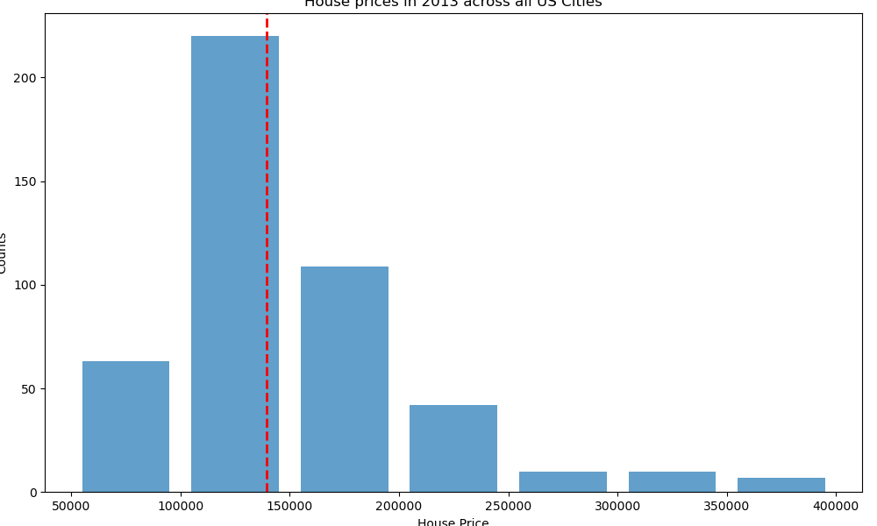
Average House price 2013 vs 2023

Slide 3
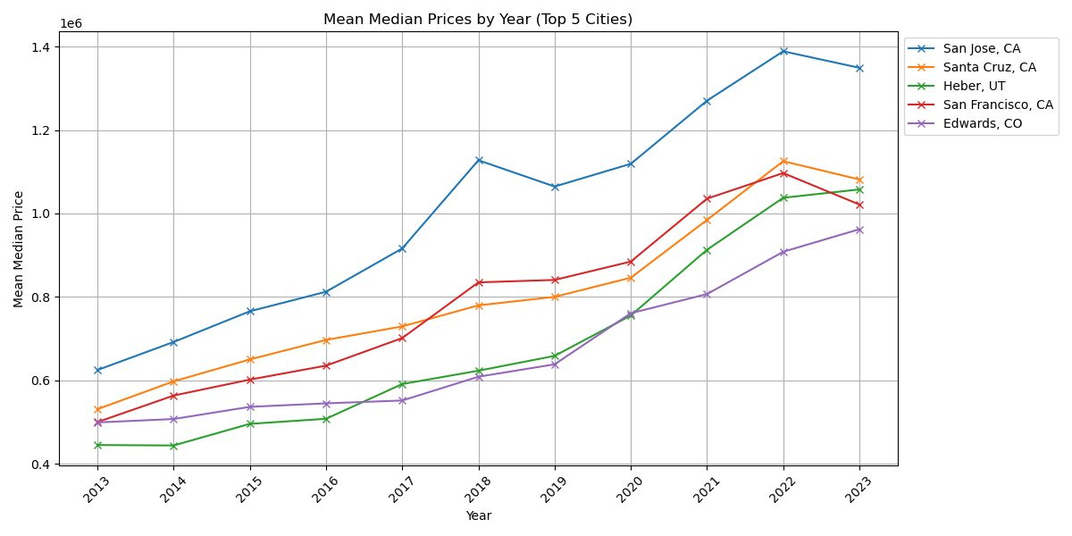
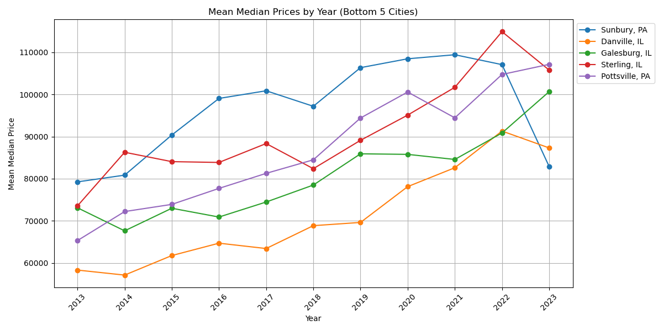
Top five vs Bottom five cities

Slide 4
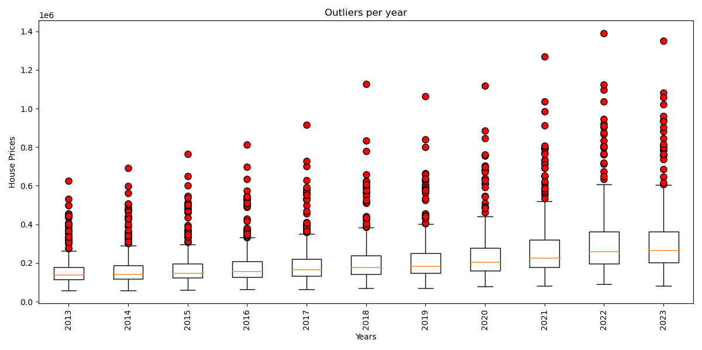
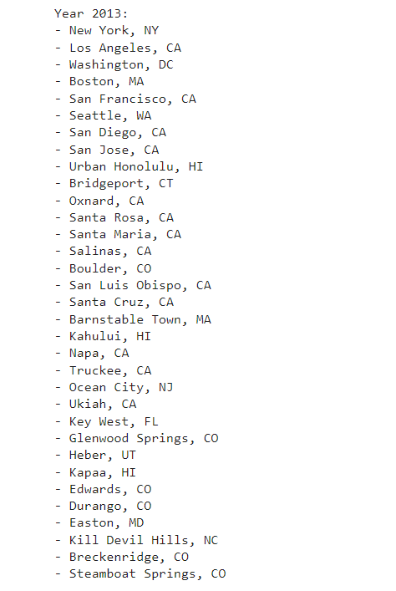
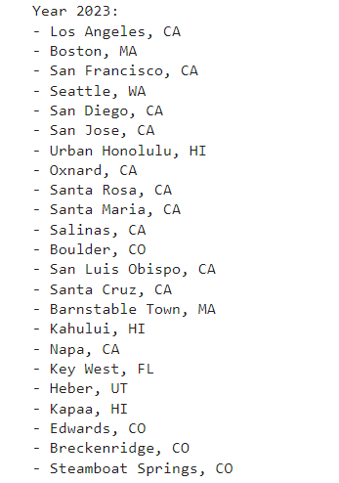
Outliers

Slide 5
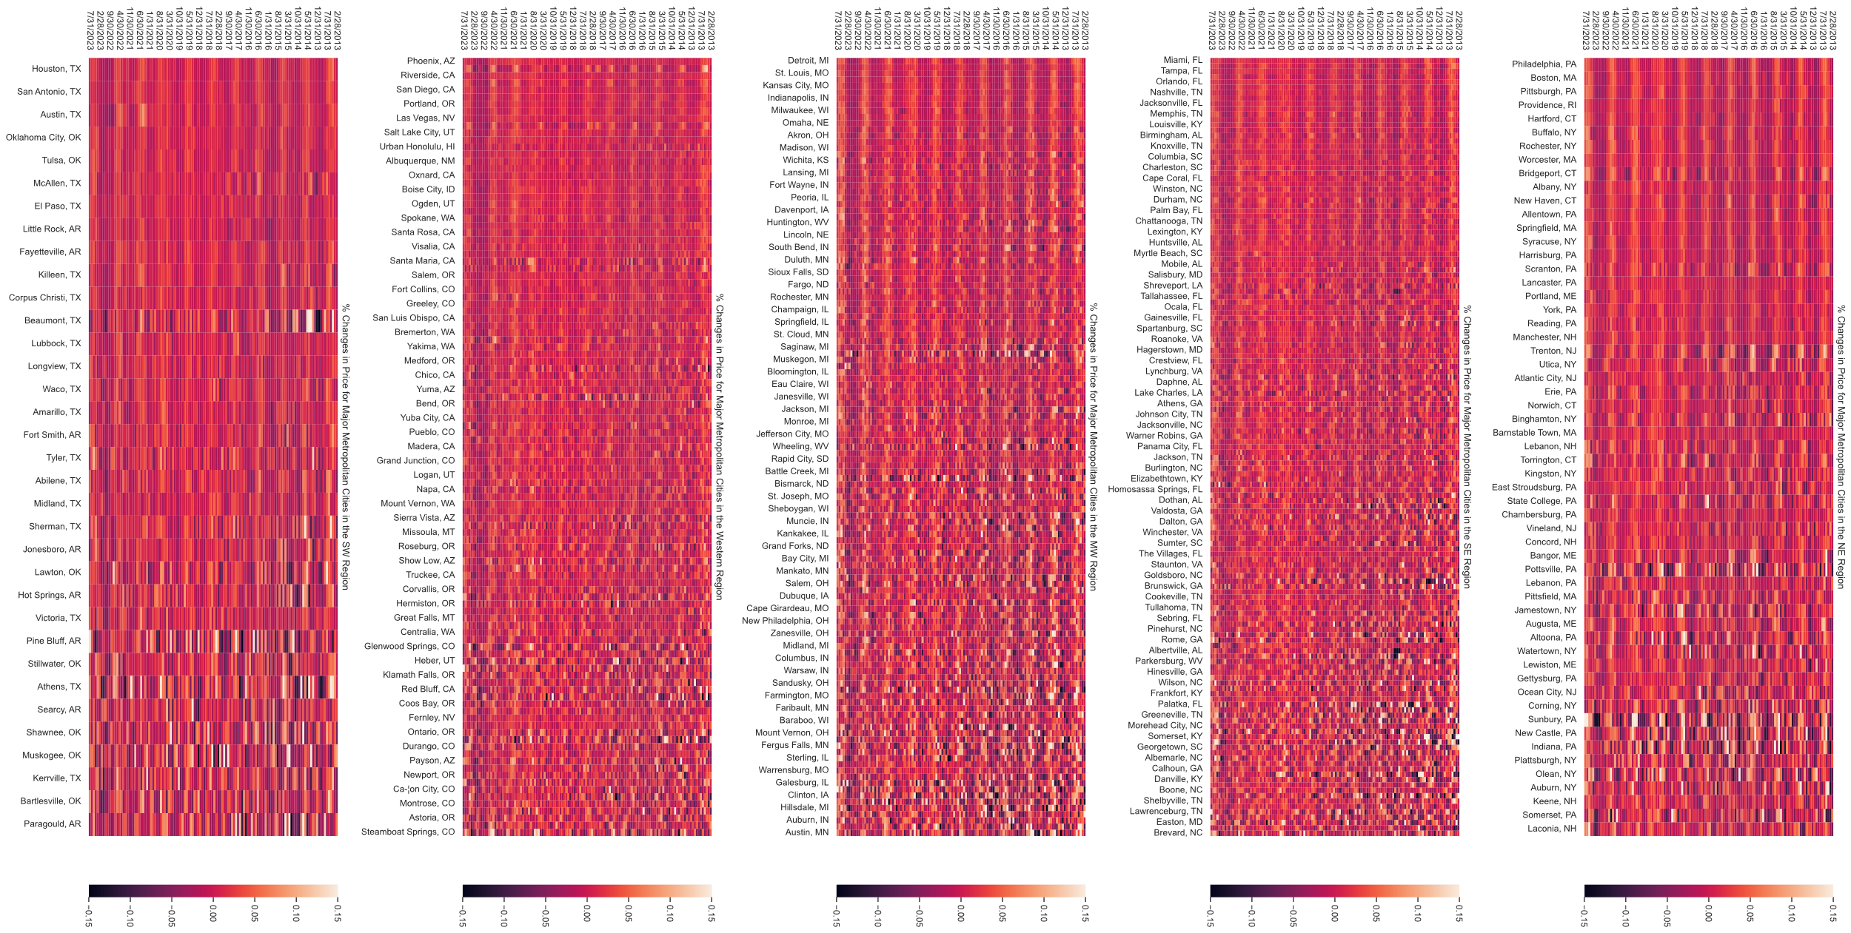
Market Volatility

Slide 6
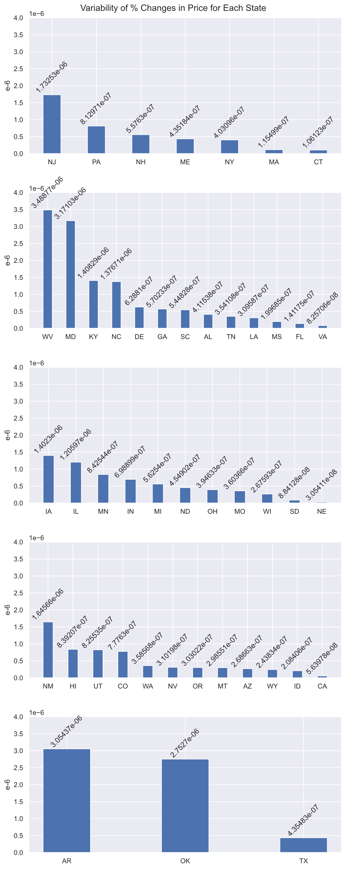
Volatility of Individual States Grouped by region

Slide 7
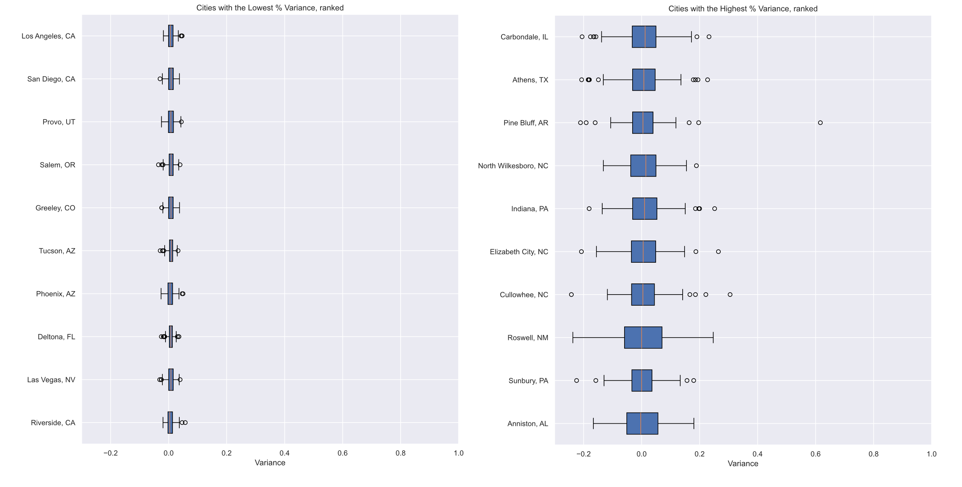
Most stable city % price changes, Historic
Most volatile city % price changes, Historic

Slide 8
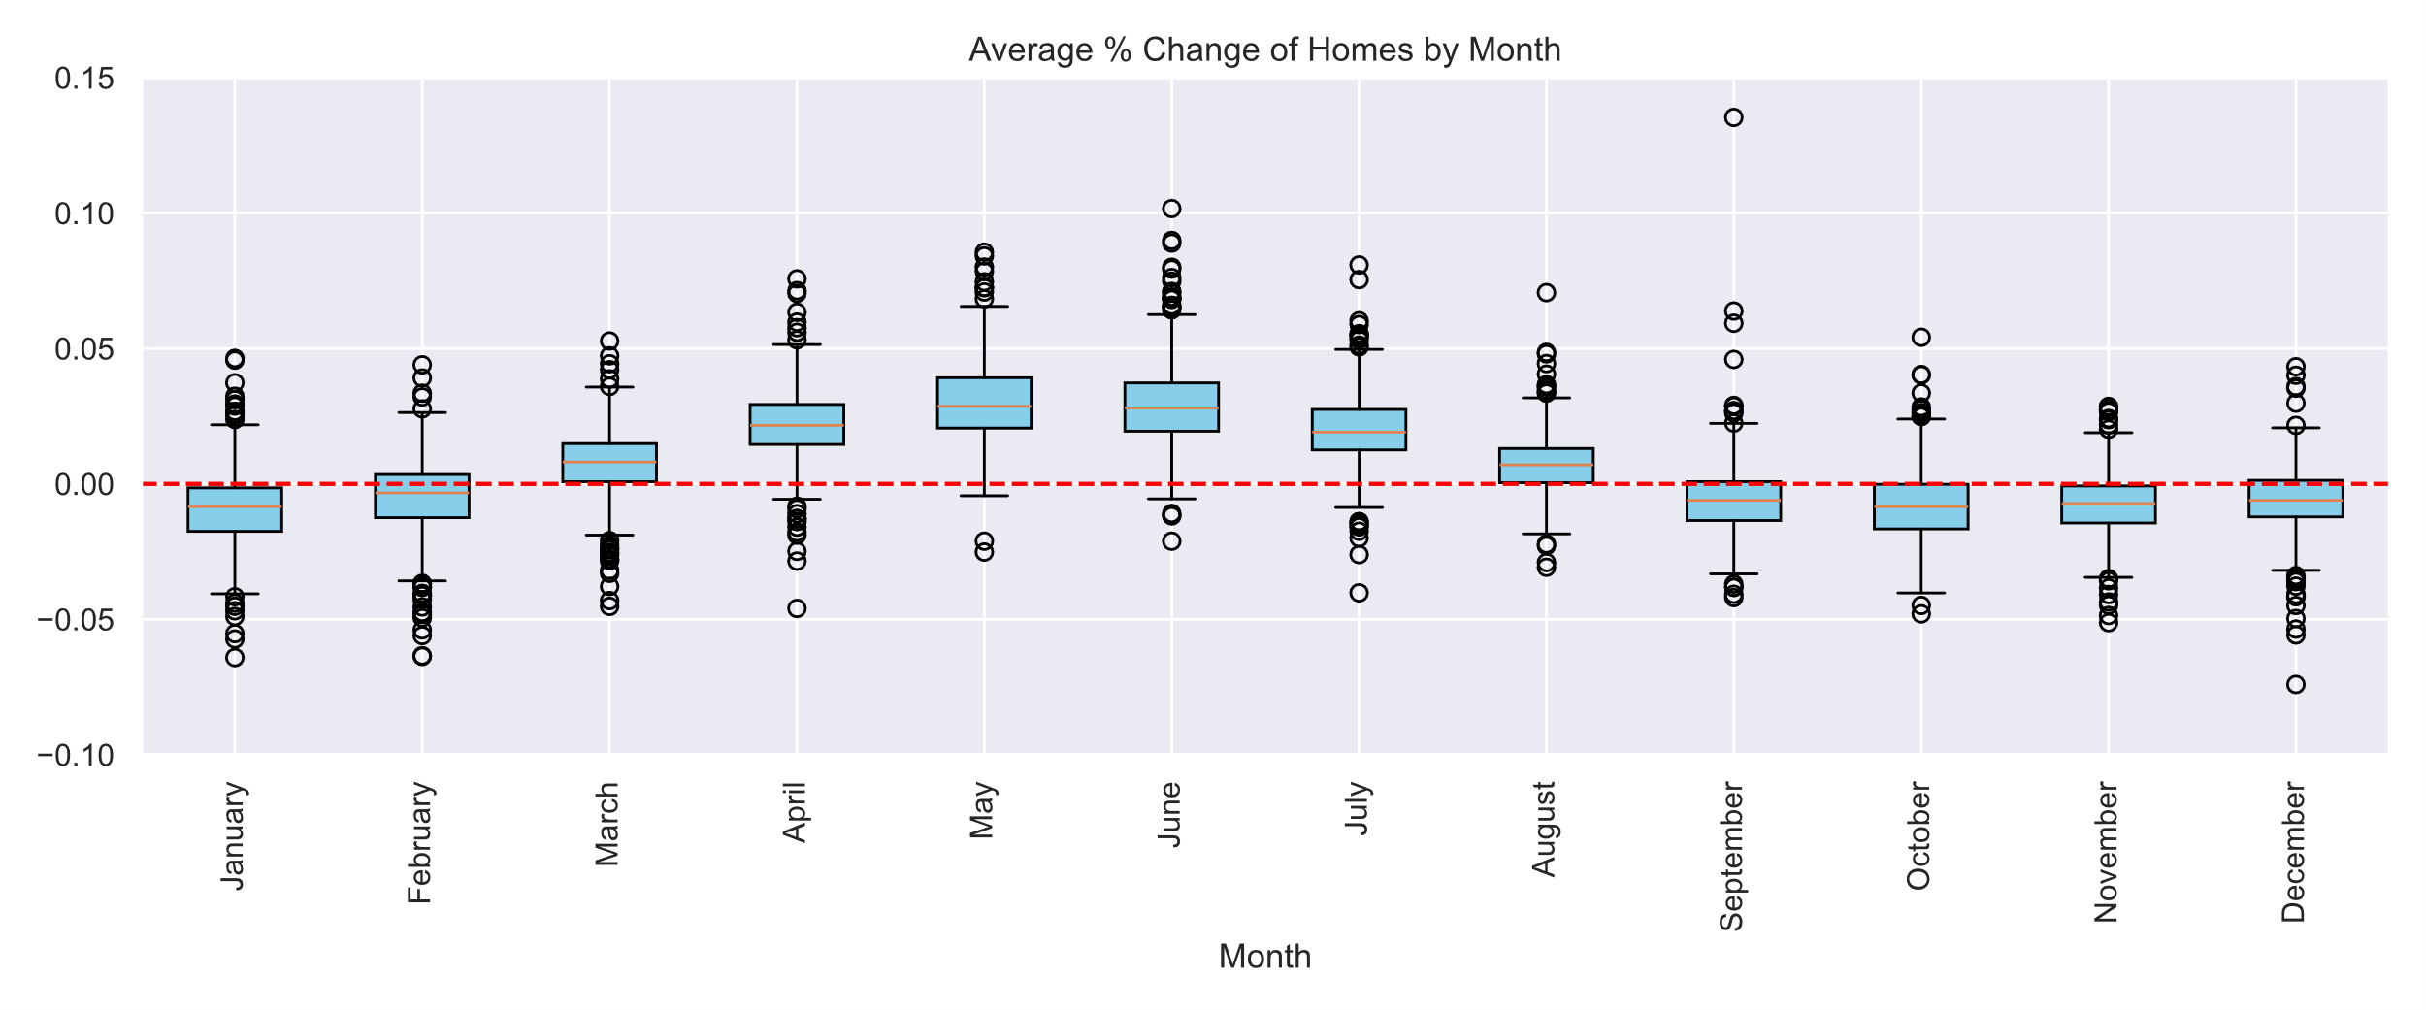
Most Volatile Months, Historic

Slide 9
Hypothesis Testing

